Slide 1



01CE0723 - DATA WAREHOUSING & DATA MINING
Unit - 1
Data warehousing
Prof. Urvi Dhamecha
Associate Professor
Computer Engineering Department

Slide 2


Outline
Introduction to Data Warehouse
Data warehouse vs Operational DBMS
Comparison of OLAP with OLTP
Multidimensional data model: Data cubes
Conceptual Modelling of Data warehouse: schemas
Multidimensional Data
OLAP operations
Data Warehouse architecture
OLAP Server Architecture: ROLAP, MOLAP

Slide 3
1.1 Introduction to Data Warehouse
Defined in many different ways, but not rigorously.
A decision support database that is maintained separately from the organization’s operational database.
Support information processing by providing a solid platform of consolidated, historical data
for analysis.
“A data warehouse is a subject-oriented, integrated, time-variant, and nonvolatile
collection of data in support of management’s decision-making process.”
—W. H. Inmon
Data warehousing:
The process of constructing and using data warehouses

Slide 4
Data Warehouse—Subject-Oriented
Organized around major subjects, such as customer, product, sales.
Focusing on the modeling and analysis of data for decision makers, not on daily
operations or transaction processing.
Provide a simple and concise view around particular subject issues by excluding
data that are not useful in the decision support process.

Slide 5
Data Warehouse—Integrated
Constructed by integrating multiple, heterogeneous data sources
relational databases, flat files, on-line transaction records
Data cleaning and data integration techniques are applied.
Ensure consistency in naming conventions, encoding structures, attribute measures, etc. among different
data sources
E.g., Hotel price: currency, tax, breakfast covered, etc.
When data is moved to the warehouse, it is converted.

Slide 6
Data Warehouse—Time Variant
The time horizon for the data warehouse is significantly longer than that of operational
systems
Operational database: current value data.
Data warehouse data: provide information from a historical perspective (e.g., past 5-10 years).
Every key structure in the data warehouse:
Contains an element of time, explicitly or implicitly.
But the key of operational data may or may not contain “time element”.

Slide 7
Data Warehouse—Nonvolatile
A physically separate store of data transformed from the operational environment
Operational update of data does not occur in the data warehouse environment
Does not require transaction processing, recovery, and concurrency control mechanisms
Requires only two operations in data accessing:
initial loading of data and access of data.

Slide 8
Data Warehouse vs. Operational DBMS
Purpose: Operational database systems are used to support day-to-day operations of an organization, while data warehouses are used to support decision-making and analysis activities.
Data Structure: Operational database systems typically have a normalized data structure, which means that the data is organized into many related tables to reduce data redundancy and improve data consistency. Data warehouses, on the other hand, typically have a denormalized data structure, which means that the data is organized into fewer tables optimized for reporting and analysis.
Data Volume: Operational database systems typically store a smaller volume of data compared to data warehouses, which may store years of historical data.
Performance: Operational database systems are optimized for transaction processing and are designed to support high-volume, high-speed transaction processing. Data warehouses, on the other hand, are optimized for querying and reporting and are designed to support complex analytical queries that may involve large volumes of data.

Slide 9
1.2 OLTP & OLAP
OLTP (on-line transaction processing)
Major task of traditional relational DBMS
Day-to-day operations: purchasing, inventory, banking, manufacturing, payroll, registration, accounting, etc.
OLAP (on-line analytical processing)
Major task of data warehouse system
Data analysis and decision making
Distinct features (OLTP vs. OLAP):
User and system orientation: customer vs. market
Data contents: current, detailed vs. historical, consolidated
Database design: ER + application vs. star + subject
View: current, local vs. evolutionary, integrated
Access patterns: update vs. read-only but complex queries

Slide 10
1.3 OLTP vs. OLAP

Slide 11
1.4 From Tables and Spreadsheets to Data Cubes
A data warehouse is based on a multidimensional data model which views data in the form of a data cube.
A data cube, such as sales, allows data to be modeled and viewed in multiple dimensions
Dimension tables, such as item (item-name, brand, type), or time(day, week, month, quarter, year)
Fact table contains measures (such as dollars-sold) and keys to each of the related dimension tables
In data warehousing literature, an n-D base cube is called a base cuboid. The top most 0-D
cuboid, which holds the highest-level of summarization, is called the apex cuboid. The lattice
of cuboids forms a data cube.

Slide 12
Cube: A Lattice of Cuboids
all
0-D(apex) cuboid
time
item
location
supplier
1-D cuboids
time,location
item,location
location,supplier
2-D cuboids
time,supplier
item,supplier
time,location,supplier
3-D cuboids
time,item,supplier
item,location,supplier
4-D(base) cuboid

Slide 13
1.5 Conceptual Modeling of Data Warehouses
Modeling data warehouses: dimensions & measures
Star schema: A fact table in the middle connected to a set of dimension tables
Snowflake schema: A refinement of star schema where some dimensional hierarchy is normalized into a set of smaller dimension tables, forming a shape similar to snowflake
Fact constellations: Multiple fact tables share dimension tables, viewed as a collection of
stars, therefore called galaxy schema or fact constellation

Slide 14
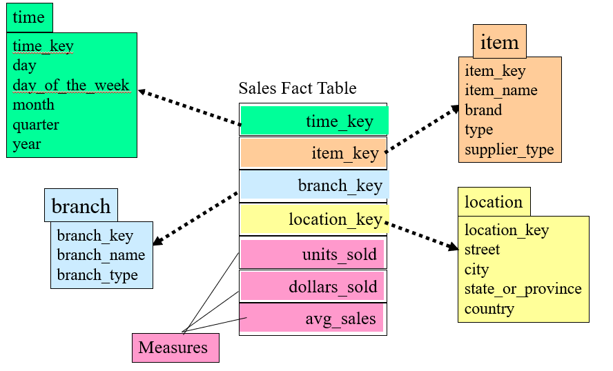
Example of Star Schema

Slide 15
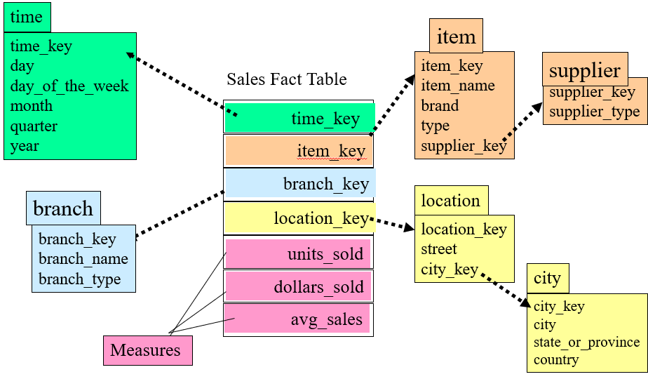
Example of Snowflake Schema

Slide 16
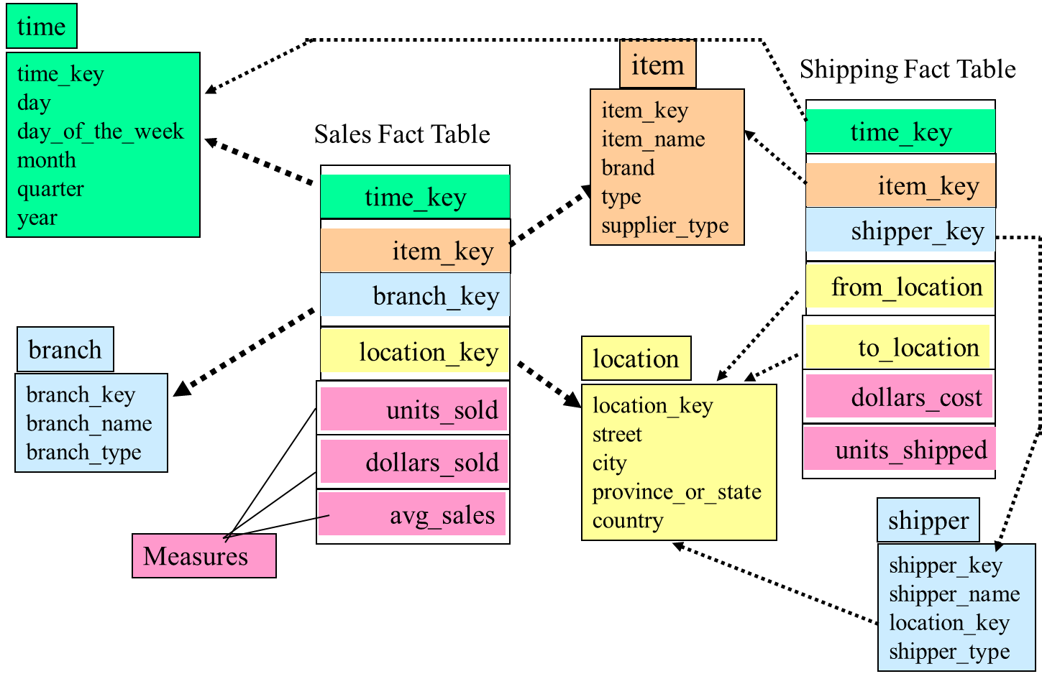
Example of Fact Constellation

Slide 17
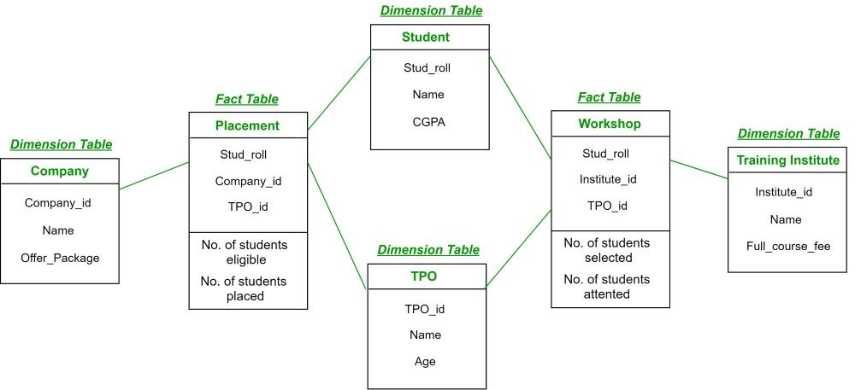
Example of Fact Constellation

Slide 18
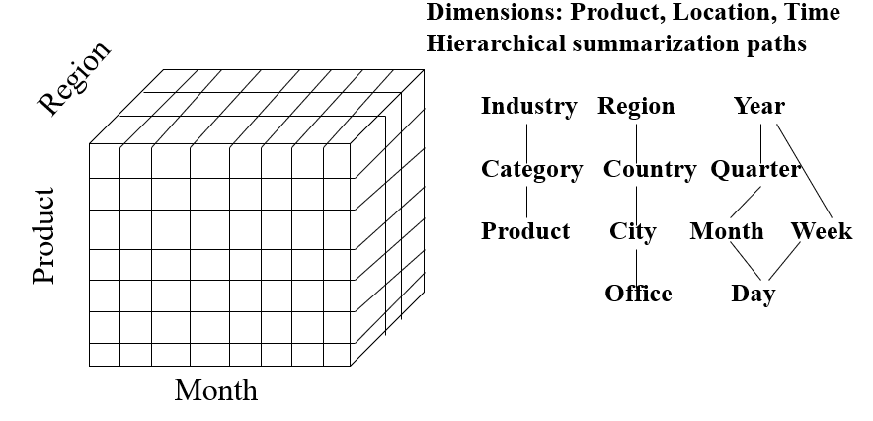
1.6 Multidimensional Data
Sales volume as a function of product, month, and region

Slide 19
A Sample Data Cube
Date
1Qtr
2Qtr
3Qtr
4Qtr
sum
Product
TV
PC
U.S.A
VCR
sum
Canada
Country
Mexico
sum
All, All, All

Slide 20
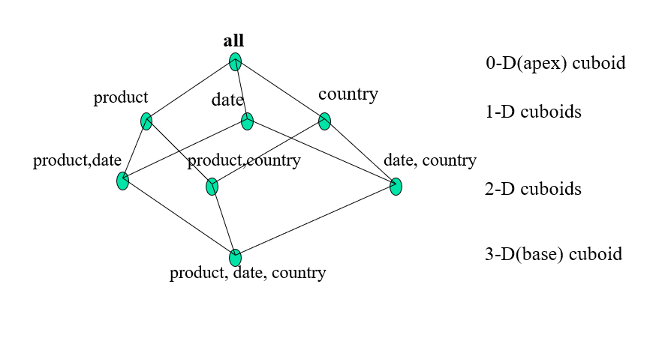
Cuboids Corresponding to the Cube

Slide 21
1.7 Typical OLAP Operations
Roll up (drill-up): summarize data
by climbing up hierarchy or by dimension reduction
Drill down (roll down): reverse of roll-up
from higher level summary to lower level summary or detailed data, or introducing new dimensions
Slice and dice: project and select
Pivot (rotate):
reorient the cube, visualization, 3D to series of 2D planes
Other operations
drill across: involving (across) more than one fact table
drill through: through the bottom level of the cube to its back-end relational tables (using SQL)

Slide 22
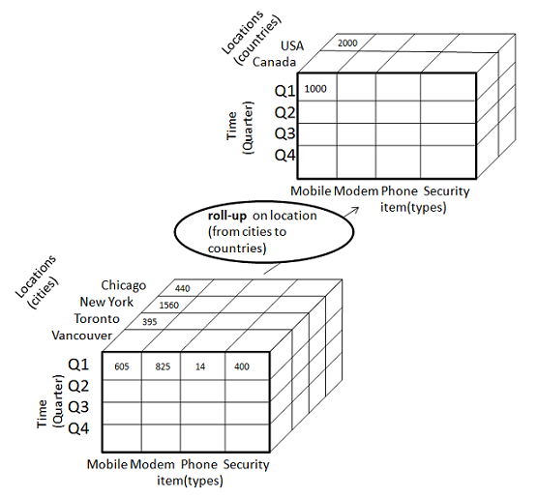
Roll Up (Drill-Up)

Slide 23
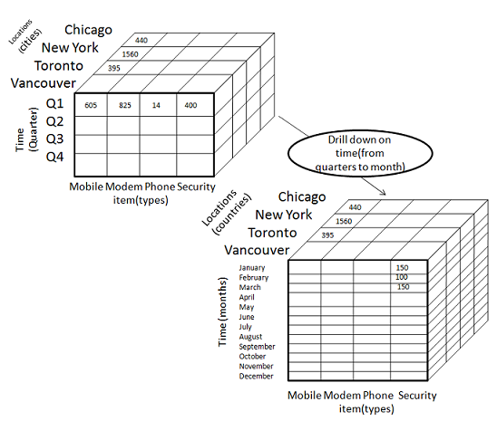
Drill Down (Roll Down)

Slide 24
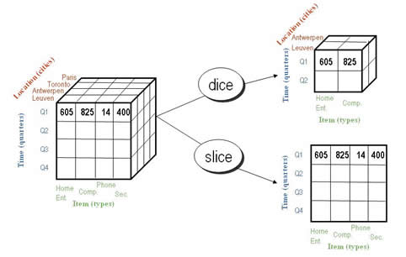
Slice and Dice

Slide 25
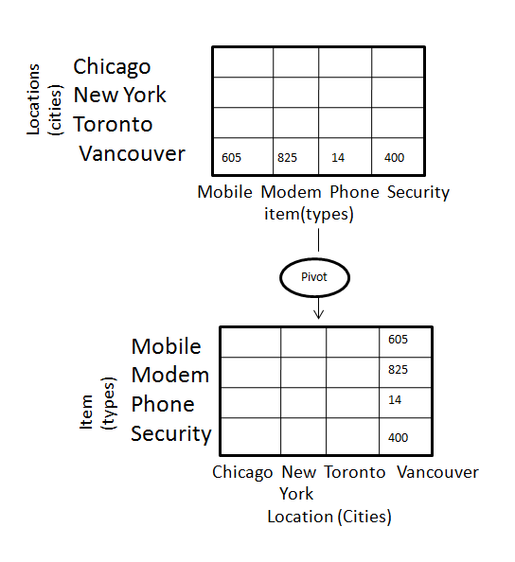
Pivot (Rotate)

Slide 26
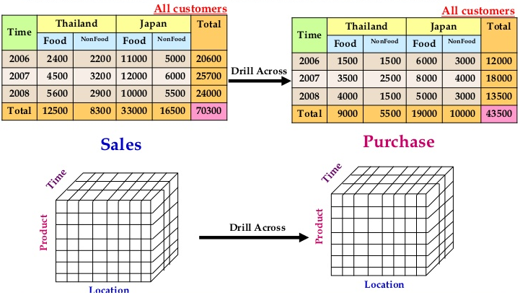
Drill Across

Slide 27
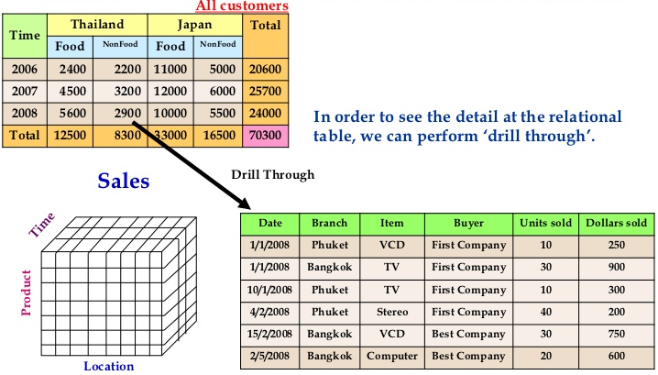
Drill Through

Slide 29
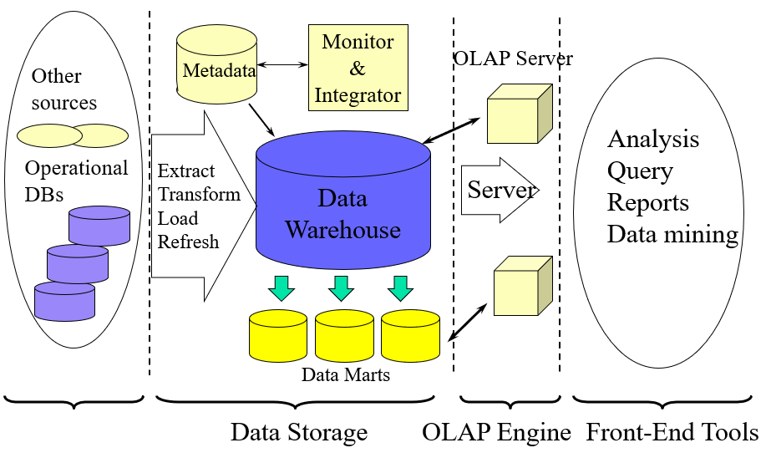
1.8 Data Warehouse: A Multi-Tiered Architecture

Slide 30
Three Data Warehouse Models
Enterprise warehouse
collects all of the information about subjects spanning the entire organization
Data Mart
a subset of corporate-wide data that is of value to a specific groups of users. Its scope is confined to specific, selected groups, such as marketing data mart
Independent vs. dependent (directly from warehouse) data mart
Virtual warehouse
A set of views over operational databases

Slide 31
Data Warehouse Back-End Tools and Utilities
Data extraction
get data from multiple, heterogeneous, and external sources
Data cleaning
detect errors in the data and rectify them when possible
Data transformation
convert data from legacy or host format to warehouse format
Load
sort, summarize, consolidate, compute views, check integrity, and build indicies and partitions
Refresh
propagate the updates from the data sources to the warehouse

Slide 32
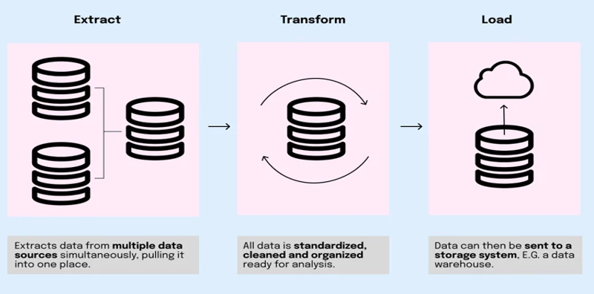
The ETL Process

Slide 33
1.9 OLAP Server Architectures
Relational OLAP (ROLAP)
Use relational or extended-relational DBMS to store and manage warehouse data and OLAP middle ware
Include optimization of DBMS backend, implementation of aggregation navigation logic, and additional tools and services
Greater scalability
Multidimensional OLAP (MOLAP)
Sparse array-based multidimensional storage engine
Fast indexing to pre-computed summarized data
Hybrid OLAP (HOLAP) (e.g., Microsoft SQLServer)
Flexibility, e.g., low level: relational, high-level: array
Specialized SQL servers
Specialized support for SQL queries over star/snowflake schemas

Slide 34
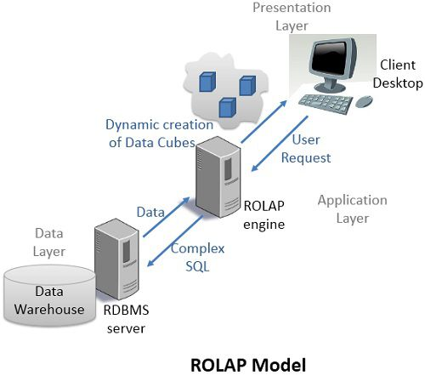
ROLAP
ROLAP is Relational Online Analytical Processing model, where the data is stored as in relational database i.e. rows and columns in the data warehouse.

Slide 35
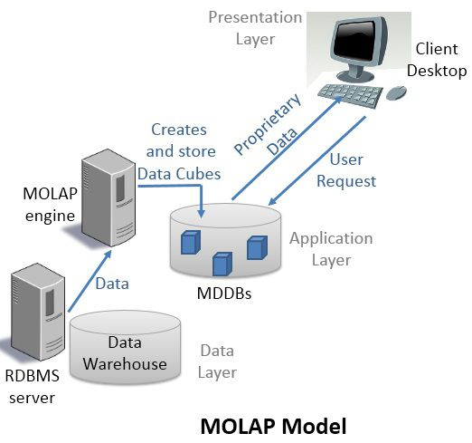
MOLAP
MOLAP is a Multidimensional Online Analytical Processing model. The data used for analysis is stored in specialized multidimensional databases (MDDBs).

Slide 36
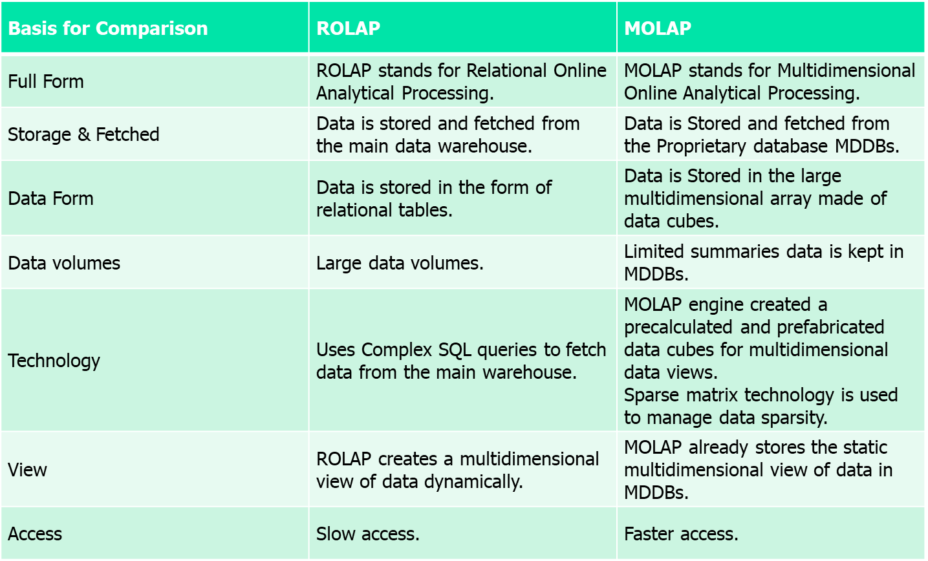
ROLAP vs. MOLAP

Slide 37
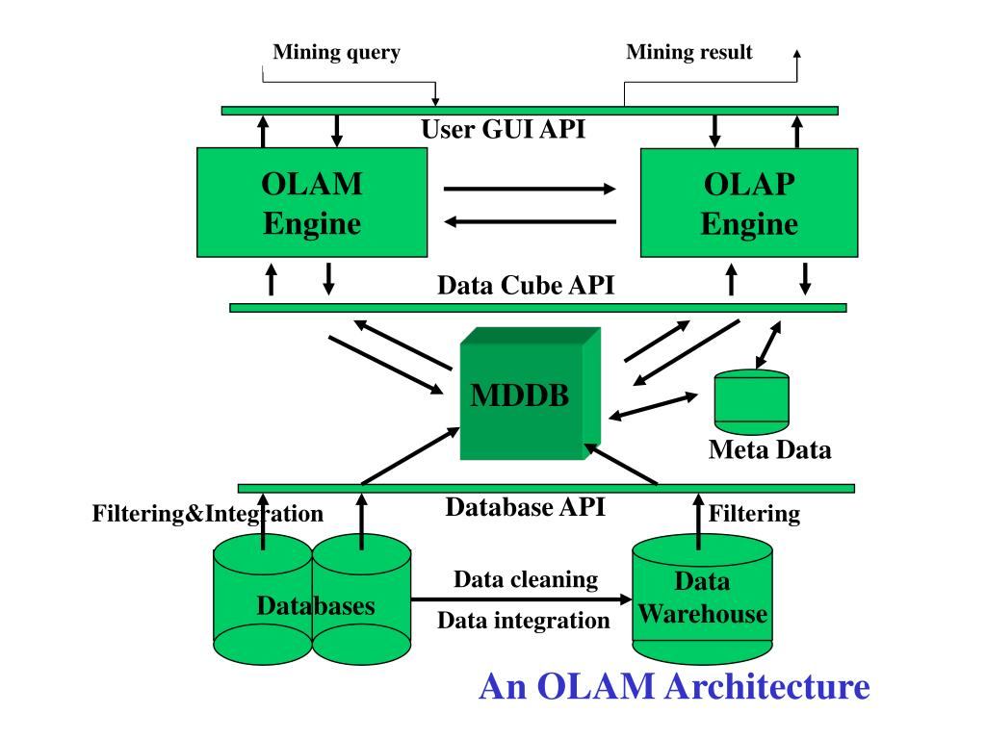
OLAM Architecture

Slide 38
References
http://www.faadooengineers.com/online-study/post/cse/datamining-and-data-ware-housing/107/on-line-analytical-processing-to-on-line-analytical-mining
https://galaktika-soft.com/blog/olap-vs-olam.html
https://www.tutorialspoint.com/data_mining/dm_evaluation.htm

Slide 39

Thank You

